Slide 1
Influential post identification on Instagram through caption and hashtag analysis
Group 2
Sreeja Kodati, Qiu Yuan Huang, Preethi Natesan Sridhar
Notes:
Good afternoon, everyone. Today, I am excited to present our research on 'Influential Post Identification on Instagram through Caption and Hashtag Analysis,'

Slide 2
Influential Post Identification on Instagram through Caption and Hashtag Analysis
Authors：Benyamin Bashari and Ehsan Fazl-Ersi
Presentation Objective:
To introduce a novel methodology for identifying influential Instagram posts and users based on text analysis of captions and hashtags.
Notes:
authored by Benyamin Bashari and Ehsan Fazl-Ersi.

Slide 3
1.
Abstract & Introduction
Briefly Introduce Purpose, Methodology and Findings
Notes:
This presentation will cover our innovative methodology and its implications for influencer marketing."

Slide 4
Abstract
Brief Overview:
Purpose: The research develops a new technique for discovering influential Instagram users by analyzing the text content of posts, focusing on hashtags and captions.
Methodology: The approach utilizes advanced word embedding methods like Co-occurrence and fastText, integrated within a support vector machine framework.
Findings: Extensive testing reveals that text data is highly effective in distinguishing influential posts, demonstrating the potential of this approach in the realm of influencer marketing.
Notes:
The research introduces a groundbreaking method for identifying influential users on Instagram by analyzing the text content of their posts. The essay focus on captions and hashtags, using advanced word embedding techniques and support vector machines. The findings demonstrate that text data is a crucial element in distinguishing influential posts, which can significantly enhance influencer marketing strategies.

Slide 5
Introduction
Background:
Highlight the shift from traditional advertising to influencer marketing due to the expansive reach and personalized impact of social media influencers.
Discuss the limitations of existing methods which mainly rely on network topology and user interactions such as likes, shares, and comments.
Paper's goal:
To leverage text analysis of user-generated content to identify influential posts and users on Instagram.
Notes:
Influencer marketing is evolving, shifting away from traditional advertising towards leveraging the power of influential individuals on social media. Existing methods often rely on user interactions and network structures. However, our study proposes a novel approach that emphasizes the analysis of user-generated content, offering a fresh perspective in identifying influential users.

Slide 6
Literature Review
Current Existing solutions for identifying influencers in social media networks:
Topological-based methods: Analyze the structural connections within the network, identifying influencers based on their position within the graph.
Interaction-based methods: Focus on user engagement metrics like likes and comments to assess influence.
Topic-based methods: Consider the content of the posts, especially keywords and topics, to determine influence.
The method proposed in this paper is closer to the topic-based approaches in that it mainly focuses on User generated content.
Notes:
The literature review categorizes existing influencer identification methods into three types: topological-based, interaction-based, and topic-based. We discuss the limitations and challenges of these methods, especially in the face of rising issues like social bots and fake accounts. The research aims to fill a critical gap by focusing solely on the content of posts rather than the broader network dynamics.

Slide 7
Text Analysis Approach
Preprocessing: Outline steps such as removal of non-English words, punctuation, and mentions; conversion to lowercase; tokenization; removal of stopwords; and stemming.
Word Embedding Techniques: Describe the use of Co-occurrence and fastText methods to create numerical representations of words in captions and hashtags.
Classification with SVM: Explain how these embeddings are fed into a support vector machine to classify posts as influential or non-influential based on their textual content.
Notes:
In this slide, we delve into the proposed method, which involves several key steps of text processing, from initial data cleaning to sophisticated word embedding techniques like Co-occurrence and fastText. Then it use a support vector machine framework to classify posts as influential or non-influential based on their textual content

Slide 8
Essay Pipeline
Text Processing
Word weighting
Representing captions
Representing hashtags
Classification
Removed non-essential text elements, standardized text format, tokenized, removed common words, and reduced words to their root forms to simplify and focus the analysis on key content.
Utilized TF-IDF to emphasize words that are frequent in individual posts but rare across all posts, highlighting their unique importance.
Employed Word2Vec and FastText for semantic word vector representations, and co-occurrence statistics to capture contextual relationships between words.
Generated a co-occurrence matrix and affinity matrix to analyze and visualize the relationships and clustering among hashtags.
Applied Support Vector Machine classifiers to distinguish influential from non-influential posts, combining results using kernel functions and adjusting their contributions for optimal classification.
Notes:
In the research, it developed a structured pipeline for identifying influential Instagram posts. And began with text processing, where they cleaned and standardized the text, then used TF-IDF for word weighting to highlight important words. For captions, it applied Word2Vec and FastText embeddings, and analyzed hashtag relationships using a co-occurrence matrix. Finally, they classified posts as influential or not using Support Vector Machines, integrating all steps for accurate identification. Prethhe will help us to dive more into it.

Slide 9
2.
Proposed Method
Detailed description of the approach

Slide 10
Proposed Method
Text Processing
Original Caption: "Just finished an amazing hike with @johndoe! #AdventureTime 🌲🥾"
Step 1: Removing Non-English words, punctuations and digits,mentions
Outcome: "Just finished an amazing hike with AdventureTime"
Step 2:Changing uppercase letters to lowercase
Outcome: "just finished an amazing hike with adventuretime"
Step 3:Tokenizing text into a list of words.
Outcome: ["just", "finished", "an", "amazing", "hike", "with", "adventuretime"]
Step 4:Removing stopwords
After Step 4:["finished", "amazing", "hike", "adventuretime"]
Step 5: Stemming.
After Step 5:["finish", "amaz", "hike", "adventuretim"]

Slide 11
Proposed Method
Text Processing
Word weighting
After Stemming, words are weighted using the TF-IDF (term frequency– inverse document frequency) approach.
Term Frequency (TF):
Total number of occurrences of a particular word in a document (i.e., post).
Example: If the word "adventure" appears 1 time in the post, the TF value for "adventure" in that post is 1.
Document Frequency (DF):
Total Number of documents (i.e., posts) in the corpus that contain a particular word
Example: If the word "adventure" appears in 50 out of 100 posts in the corpus, the DF value for "adventure" is 50.
Conclusion: Higher TF-IDF values indicate that the word is more important in the given document and across the corpus.
.

Slide 12
Proposed Method
Text Processing
Word weighting
Representing captions
.
Word Embedding - represent words as vectors of real numbers
Two different approaches are proposed to represent captions:
Method 1:
Word2Vec: Represents words' semantics in a multidimensional vector.
FastText: Similar to Word2Vec but utilizes character n-grams for word vectors, overcoming infrequency challenges.
Method 2:
Co-occurrence Statistics: Similar to BoW(bag-of-words) model, forming a dictionary of keywords based on frequent occurrences.
Example: "The cat sat on the mat."
Word2Vec
"the": [0.2, -0.1]
"cat": [0.5, 0.3]
FastText
"cat": [0.5, 0.3, -0.1, 0.4, -0.2]
"sat": [-0.4, 0.6, 0.2, -0.3, 0.1]
Co-occurrence
Co-occurrence count for ("cat", "sat"): 1
Co-occurrence count for ("cat", "on"): 0

Slide 13
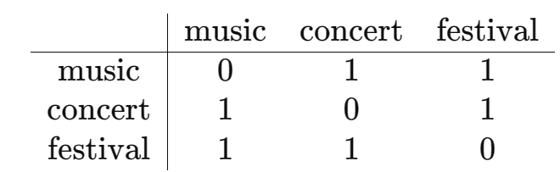
Proposed Method
Text Processing
Word weighting
Representing captions
Representing hashtags
The method proposed in this paper for hashtag representation uses the co-occurrence statistics method.
Example:
Post 1: #music #concert
Post 2: #music #festival
Post 3: #concert #livemusic
Co-occurrence Matrix:
We create a matrix to track how often hashtags appear together:
Affinity Matrix:
We calculate the similarity between hashtags based on their co-occurrence.
Cluster algorithm is used to find the frequency of hashtags belonging to each cluster.
.

Slide 14
Proposed Method
Text Processing
Word weighting
Representing captions
Representing hashtags
Classification
.
Feature Extraction:
These features capture the essential characteristics of each post.
Binary Classification:
Classify each post as either influential or non-influential.
Support Vector Machine (SVM) Classifiers:
Two SVM classifiers are employed for this task—one for hashtags and another for captions. SVM is a popular machine learning algorithm used for classification tasks.
Kernel Combination:
The outputs of the SVM classifiers are combined in the kernel space.
Kernel Functions:
The kernel functions help capture the relationships between data points in the feature space.
Weighting:
This ensures that each kernel contributes appropriately to the final classification decision.

Slide 15
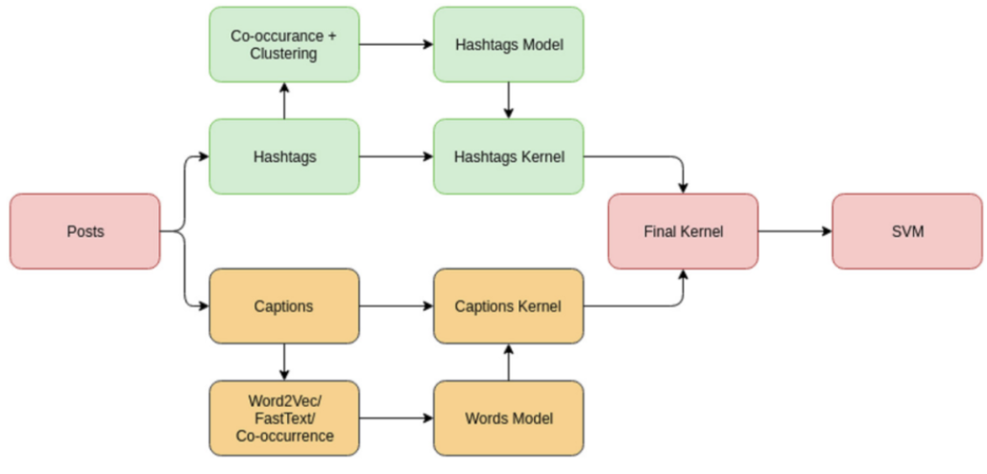
Proposed Method
Text Processing
Word weighting
Representing captions
Representing hashtags
Classification
.
Figure 1:Training phase

Slide 16
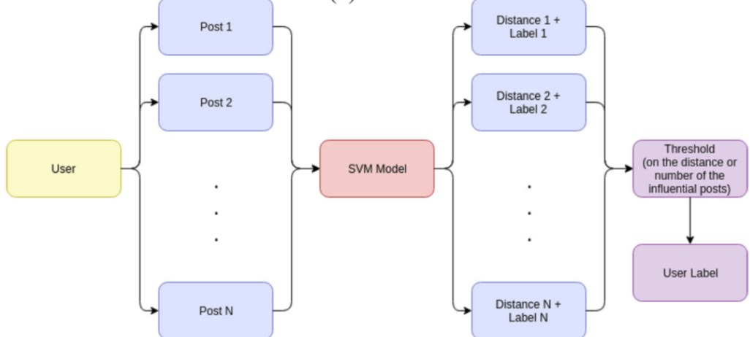
Proposed Method
Text Processing
Word weighting
Representing captions
Representing hashtags
Classification
.
Figure 2: testing phase of the proposed method, for identifying both influential posts and users.

Slide 17
3.
Experiments
Data gathering, Data preparation and Results

Slide 18
Data gathering
Used a set of Instagram users listed as influencers at http://www.pro.iconosquare.com/
To form the non-influencer’s set, users from the set of influencers’ followers who are fairly active and have less than 200 connections were considered.
The data for each of the influencer and non-influencer users was gathered using Instagram's API.
User’ data collected includes bio, number of followers, number of followings and posts.
Each post had information about the media ID, caption, hashtag and image URL.

Slide 19
Data preparation
Three cleaning steps were considered to remove the potential effects that the posts’ topic or individual writing style:
10 most frequently mentioned hashtags were identified.
A threshold on the maximum number of posts a user can contribute to each experiment was introduced. The value was set to 200.
To ensure that the training and testing splits for each experiment are almost balanced, a dynamic programming algorithm known as coin change was used.
The final dataset contains 16,038 posts that belong to 2272 users; of which, 346 are influencers and 1926 are non-influencers.

Slide 20
Results of Post classification
Model accuracy: 65.51%
Goal: classifying an Instagram post into Influencer (Inf.) and Non-Influencer (NInf.) categories.
The accuracy of various representation methods is often improved through the use of TF-IDF (except for the Word2Vec model).
According to the results, hashtags appear to play a more significant role in distinguishing influential posts from non-influential ones, when compared to each method of caption representation.
As for the classification solutions based on captions, the proposed co-occurrence statistics method achieves higher accuracy.

Slide 21
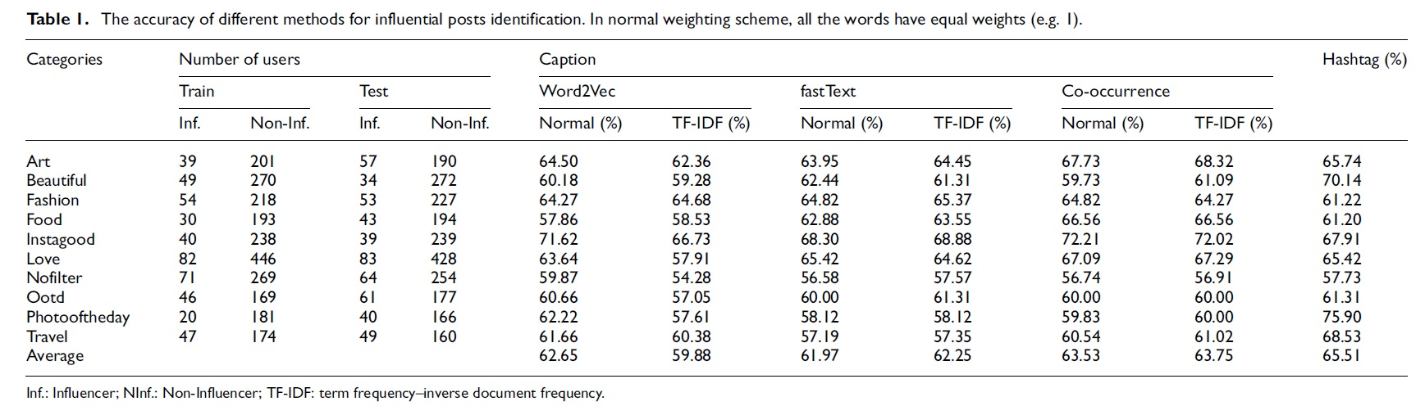
Accuracy results for Post classification

Slide 22
Results of Influencer classification
Two experiments were performed to help identify influencers on Instagram. An influencer is identified by:
the number of influential posts (threshold was set to 85%)
Average likelihood of their post being influential reaching a certain threshold (value was set to 0.48).
The best accuracy for experiment (a) is 83.64% and for experiment (b) is 83.19%

Slide 23
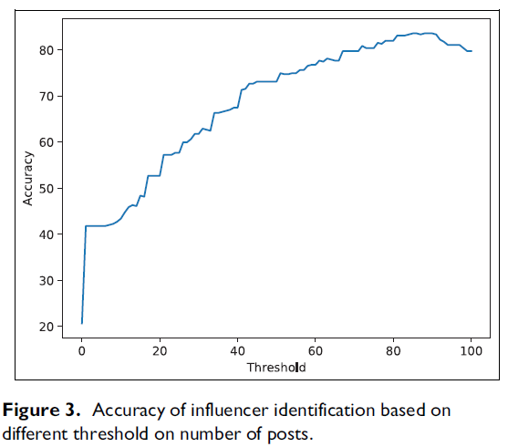
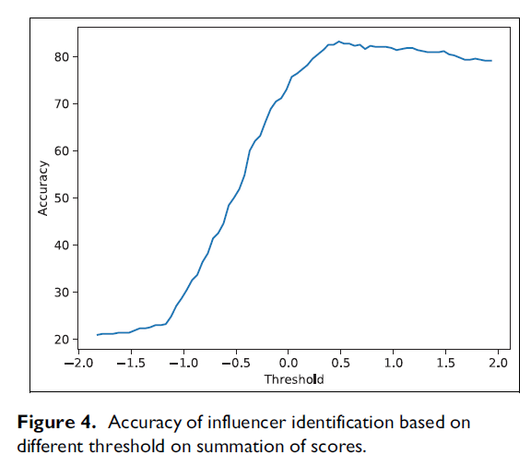
Accuracy results for Influencer classification

Slide 24
4.
Conclusion
Conclusion and future works

Slide 25
Conclusion
Key Findings:
Innovative Approach: Introduced a novel method focused solely on analyzing user-generated content (UGC) from Instagram posts through advanced text analysis and natural language processing techniques.
Significant Contribution: Instagram is nearly two and a half times the size of Twitter, and many and big brands are putting more effort into Instagram. Currently, no major study has been conducted to identify influencers on Instagram based on analyzing ugc.
Advantages:
Focus on UGC: Emphasizes the potential of textual content in posts, a significant yet often overlooked source of data in influencer identification.
High Accuracy: Demonstrated promising results in accurately identifying influential posts and users, validating the effectiveness of the method.
Notes:
In conclusion, the research introduced a novel approach to identifying influential users on Instagram by focusing solely on the analysis of user-generated content through advanced text analysis and natural language processing techniques. This method is particularly significant as it taps into the often overlooked textual content of posts, setting it apart from previous approaches that predominantly considered user interactions and network structures. The findings show high accuracy in identifying influential posts, underscoring the method's effectiveness.

Slide 26
Conclusion
Future Research Directions:
Integration with Other Methods:
Combine this text-focused approach with analyses that use the topological structure of social networks or user interactions to create a more holistic influencer identification system.
Expansion to Multi-Media Content:
Develop methods that incorporate not just text but also media elements like images and videos to provide a complete representation of user posts and influence.
Visual Elements:
Chart or Graph: Show a simple chart or diagram illustrating the current method’s focus area compared to potential future expansions.
Icons or Bullet Points: Use icons for visual emphasis on key points like text analysis, network structure, and multimedia content.
Notes:
Looking ahead, the author plan to integrate this approach with analyses that consider network topology and user interactions to enhance its comprehensiveness. Additionally, the author aim to expand our method to include multimedia content like images and videos for a more holistic view of user influence. These future directions will help us develop a more robust system for influencer identification in social networks.

Slide 27
Thank You!

